Slide 1
STORY MAPING TEMPLATE
This “Story Mapping Template” is created by Learnovative to help their participants to use in their projects. Anyone who is interested in using this template can feel free to download and use it.
Steps to create the Story Mapping:
Identify the “Backbone” elements (Highlighted in the next slide)
Prepare the “Walking skeleton” elements (Highlighted in the next slide)
Prioritize the walking skeleton items using any prioritization technique (DOT voting/MoSCoW/etc)
Decide the scope of the release by identifying the walking skeleton items for the release
Move the selected walking skeleton items into your Product Backlog
You can find a sample User Story Mapping to give you an idea on how to create a User Story Mapping

Slide 2
STORY MAPING TEMPLATE
Backbone Element 1
Backbone Element 2
Backbone Element 3
Backbone Element 4
BACKBONE (Targeted Epics/Features for the Release)
HIGH
Important
WALKING SKELETON
User stories for each of the backbone element.
Once you write the user stories, prioritize them in such a way that, important items are towards top and not important items are in the bottom.
RELEASE SCOPE
LOW
Important

Slide 3
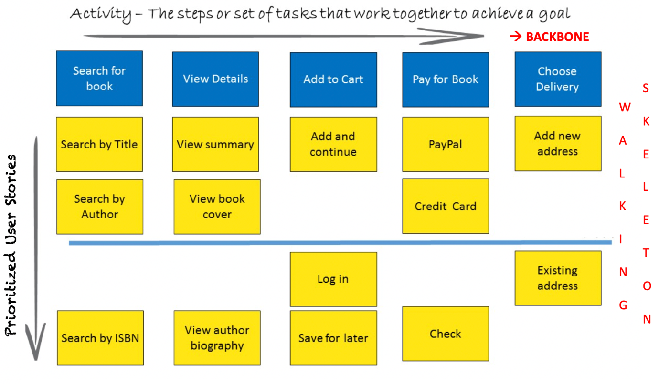
STORY MAPING EXAMPLE

